Slide 1
CS162 Operating Systems and Systems Programming Lecture 24 Filesystems 4: Buffering, Reliability, Transactions
April 18th, 2023
Prof. John Kubiatowicz
http://cs162.eecs.Berkeley.edu

Slide 2

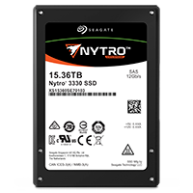
Recall: From Storage to File Systems
I/O API and
syscalls
Variable-Size Buffer
Memory Address
Logical Index, Typically 4 KB
File System
Block
Flash Trans. Layer
Hardware Devices
Sector(s)
Sector(s)
Sector(s)
Phys. Block
Phys Index., 4KB
Physical Index,
512B or 4KB
Erasure Page
HDD
SSD

Slide 3
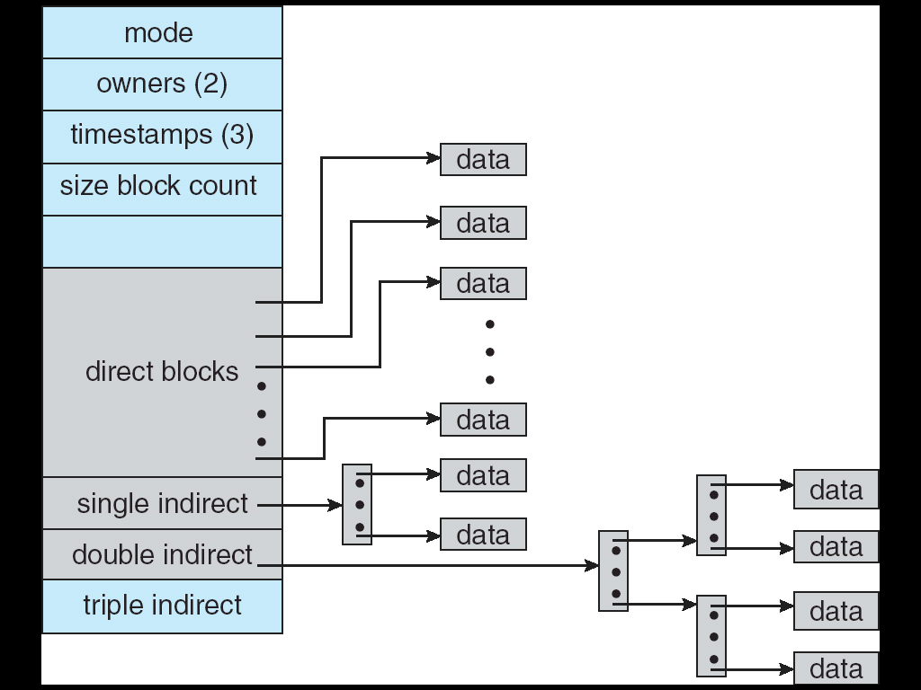
Need for Cache Between FileSystem and Devices
I/O API and
syscalls
Variable-Size Buffer
Memory Address
Not block-sized or block-aligned
access
File System
(Block Based)
Logical Index, Typically 4 KB
Reuse of inodes,
indirect blocks, data blocks
Speed up access to file system path and data
Slow access to
Data blocks of
fixed size!
Buffer Cache (Block Based)
Flash Trans. Layer
Hardware Devices
free
free
Sector(s)
Sector(s)
Sector(s)
Phys. Block
Phys Index., 4KB
Flash Trans. Layer
Apparent speed and flexibility is greater because of Buffer Cache
Physical Index,
512B or 4KB
Erasure Page
Hardware Devices
Sector(s)
Sector(s)
Sector(s)
Phys. Block
Phys Index., 4KB
HDD
SSD
Physical Index,
512B or 4KB
Erasure Page
HDD
SSD

Slide 4
Buffer Cache: Motivation
Buffer Cache (Block Based)
Blocks
free
free
State
Kernel must copy disk blocks to memory (somewhere) to access their contents and write them back if modified
Could be data blocks, inodes, directory contents, etc.
Possibly dirty (modified and not yet written back)
Key Idea: Exploit locality by caching disk data in memory
Name translations: Mapping from paths→inodes
Disk blocks: Mapping from block address→disk content
Buffer Cache: Memory used to cache kernel resources, including disk blocks and name translations
Can contain “dirty” blocks (with modifications not on disk)

Slide 5
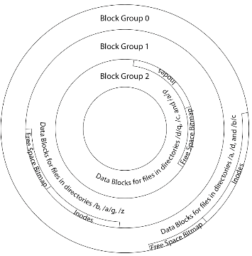
File System Buffer Cache
Data blocks
Disk
Reading
OS implements a cache of disk blocks for efficient access to data, directories, inodes, freemap
PCB
iNodes
file desc
Writing
Dir Data blocks
Free bitmap
Memory
Blocks
State
free
free

Slide 6
File System Buffer Cache: open
Data blocks
Disk
Directory lookup repeat as needed:
load block of directory
search for map
Reading
PCB
iNodes
file desc
Writing
Dir Data blocks
Free bitmap
Memory
Blocks
State
free
free
rd
dir

Slide 7
File System Buffer Cache: open
Data blocks
Disk
Directory lookup repeat as needed:
load block of directory
search for map
Create reference via open file descriptor
Reading
PCB
iNodes
file desc
Writing
Dir Data blocks
<name>:inumber
Free bitmap
Memory
Blocks
State
free
dir
inode
rd

Slide 8
File System Buffer Cache: Read?
Data blocks
Disk
Read Process
From inode, traverse index structure to find data block
load data block
copy all or part to read data buffer
Reading
PCB
iNodes
file desc
Writing
Dir Data blocks
<name>:inumber
Free bitmap
Memory
Blocks
State
free
dir
inode

Slide 9
File System Buffer Cache: Write?
Data blocks
Disk
Process similar to read, but may allocate new blocks (update free map), blocks need to be written back to disk; inode?
Reading
PCB
iNodes
file desc
Writing
Dir Data blocks
<name>:inumber
Free bitmap
Memory
Blocks
State
free
dir
inode

Slide 10
File System Buffer Cache: Eviction?
Data blocks
Disk
Blocks being written back to disc go through a transient state
Reading
PCB
iNodes
file desc
Writing
Dir Data blocks
<name>:inumber
Free bitmap
Memory
Blocks
State
free
dir
dirty
inode

Slide 11
Buffer Cache Discussion
Implemented entirely in OS software
Unlike memory caches and TLB
Blocks go through transitional states between free and in-use
Being read from disk, being written to disk
Other processes can run, etc.
Blocks are used for a variety of purposes
inodes, data for dirs and files, freemap
OS maintains pointers into them
Termination – e.g., process exit – open, read, write
Data flushed to disk if necessary
Replacement – what to do when it fills up?

Slide 12
File System Caching
Replacement policy? LRU
Can afford overhead full LRU implementation
Advantages:
Works very well for name translation
Works well in general as long as memory is big enough to accommodate a host’s working set of files.
Disadvantages:
Fails when some application scans through file system, thereby flushing the cache with data used only once
Example: find . –exec grep foo {} \;
Other Replacement Policies?
Some systems allow applications to request other policies
Example, ‘Use Once’:
File system can discard blocks as soon as they are used

Slide 13
File System Caching (con’t)
Cache Size: How much memory should the OS allocate to the buffer cache vs virtual memory?
Too much memory to the file system cache ⇒ won’t be able to run many applications
Too little memory to file system cache ⇒ many applications may run slowly (disk caching not effective)
Solution: adjust boundary dynamically so that the disk access rates for paging and file access are balanced

Slide 14
Administrivia
Midterm 3: Next Thursday!
No class on day of midterm
Three double-sided pages of notes
Watch for Ed post about where you should go: we have multiple exam rooms
Confict request form due Thursday!
All material up to next Tuesday’s lecture is fair game

Slide 15
File System Prefetching
Read Ahead Prefetching: fetch sequential blocks early
Key Idea: exploit fact that most common file access is sequential by prefetching subsequent disk blocks ahead of current read request
Elevator algorithm can efficiently interleave prefetches from concurrent applications
How much to prefetch?
Too much prefetching imposes delays on requests by other applications
Too little prefetching causes many seeks (and rotational delays) among concurrent file requests

Slide 16
Delayed Writes
Buffer cache is a writeback cache (writes are termed “Delayed Writes”)
write() copies data from user space to kernel buffer cache
Quick return to user space
read() is fulfilled by the cache, so reads see the results of writes
Even if the data has not reached disk
When does data from a write syscall finally reach disk?
When the buffer cache is full (e.g., we need to evict something)
When the buffer cache is flushed periodically (in case we crash)

Slide 17
Delayed Writes (Advantages)
Performance advantage: return to user quickly without writing to disk!
Disk scheduler can efficiently order lots of requests
Elevator Algorithm can rearrange writes to avoid random seeks
Delay block allocation:
May be able to allocate multiple blocks at same time for file, keep them contiguous
Some files never actually make it all the way to disk
Many short-lived files!

Slide 18
Buffer Caching vs. Demand Paging
Replacement Policy?
Demand Paging: LRU is infeasible; use approximation (like NRU/Clock)
Buffer Cache: LRU is OK
Eviction Policy?
Demand Paging: evict not-recently-used pages when memory is close to full
Buffer Cache: write back dirty blocks periodically, even if used recently
Why? To minimize data loss in case of a crash

Slide 19
Dealing with Persistent State
Buffer Cache: write back dirty blocks periodically, even if used recently
Why? To minimize data loss in case of a crash
Linux does periodic flush every 30 seconds
Not foolproof! Can still crash with dirty blocks in the cache
What if the dirty block was for a directory?
Lose pointer to file’s inode (leak space)
File system now in inconsistent state ☹
Takeaway: File systems need
recovery mechanisms

Slide 20
Important “ilities”
Availability: the probability that the system can accept and process requests
Measured in “nines” of probability: e.g. 99.9% probability is “3-nines of availability”
Key idea here is independence of failures
Durability: the ability of a system to recover data despite faults
This idea is fault tolerance applied to data
Doesn’t necessarily imply availability: information on pyramids was very durable, but could not be accessed until discovery of Rosetta Stone
Reliability: the ability of a system or component to perform its required functions under stated conditions for a specified period of time (IEEE definition)
Usually stronger than simply availability: means that the system is not only “up”, but also working correctly
Includes availability, security, fault tolerance/durability
Must make sure data survives system crashes, disk crashes, other problems

Slide 21
How to make File Systems more Durable?

Slide 22
How to Make File Systems more Durable?
Disk blocks contain Reed-Solomon error correcting codes (ECC) to deal with small defects in disk drive
Can allow recovery of data from small media defects
Make sure writes survive in short term
Either abandon delayed writes or
Use special, battery-backed RAM (called non-volatile RAM or NVRAM) for dirty blocks in buffer cache
Make sure that data survives in long term
Need to replicate! More than one copy of data!
Important element: independence of failure
Could put copies on one disk, but if disk head fails…
Could put copies on different disks, but if server fails…
Could put copies on different servers, but if building is struck by lightning….
Could put copies on servers in different continents…

Slide 23
RAID 1: Disk Mirroring/Shadowing
Redundant Array of Inexpensive Disks
(developed here at Berkeley!)
recovery
group
Each disk is fully duplicated onto its “shadow”
For high I/O rate, high availability environments
Most expensive solution: 100% capacity overhead
Bandwidth sacrificed on write:
Logical write = two physical writes
Highest bandwidth when disk heads and rotation synchronized (challenging)
Reads may be optimized
Can have two independent reads to same data
Recovery:
Disk failure ⇒ replace disk and copy data to new disk
Hot Spare: idle disk attached to system for immediate replacement

Slide 24
RAID 5+: High I/O Rate Parity
Stripe Unit
Data stripped across multiple disks
Successive blocks stored on successive (non-parity) disks
Increased bandwidth over single disk
Parity block (in green) constructed by XORing data blocks in stripe
P0=D0⊕D1⊕D2⊕D3
Can destroy any one disk and still reconstruct data
Suppose Disk 3 fails, then can reconstruct: D2=D0⊕D1⊕D3⊕P0
Can spread information widely across internet for durability
RAID algorithms work over geographic scale
D0
D1
D2
D3
P0
D4
D5
D6
P1
D7
Increasing
Logical
Disk
Addresses
D8
D9
P2
D10
D11
D12
P3
D13
D14
D15
P4
D16
D17
D18
D19
D20
D21
D22
D23
P5
Disk 1
Disk 2
Disk 3
Disk 4
Disk 5

Slide 25
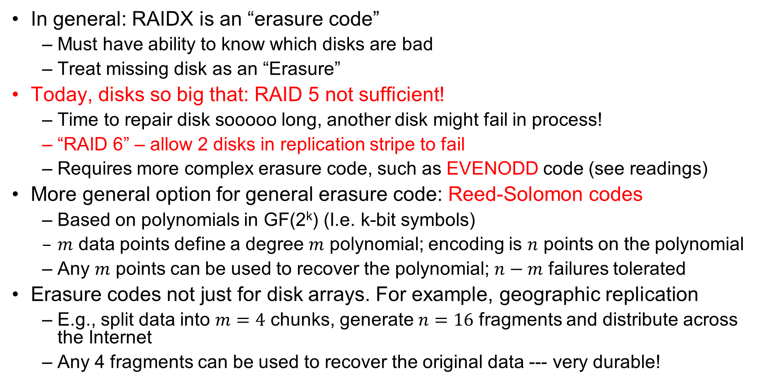
RAID 6 and other Erasure Codes
In general: RAIDX is an “erasure code”
Must have ability to know which disks are bad
Treat missing disk as an “Erasure”
Today, disks so big that: RAID 5 not sufficient!
Time to repair disk sooooo long, another disk might fail in process!
“RAID 6” – allow 2 disks in replication stripe to fail
Requires more complex erasure code, such as EVENODD code (see readings)
More general option for general erasure code: Reed-Solomon codes
Based on polynomials in GF(2^{k}) (I.e. k-bit symbols)
$m$ data points define a degree $m$ polynomial; encoding is $n$ points on the polynomial
Any $m$ points can be used to recover the polynomial; $n−m$ failures tolerated
Erasure codes not just for disk arrays. For example, geographic replication
E.g., split data into $m=4$ chunks, generate $n=16$ fragments and distribute across the Internet
Any 4 fragments can be used to recover the original data --- very durable!

Slide 26
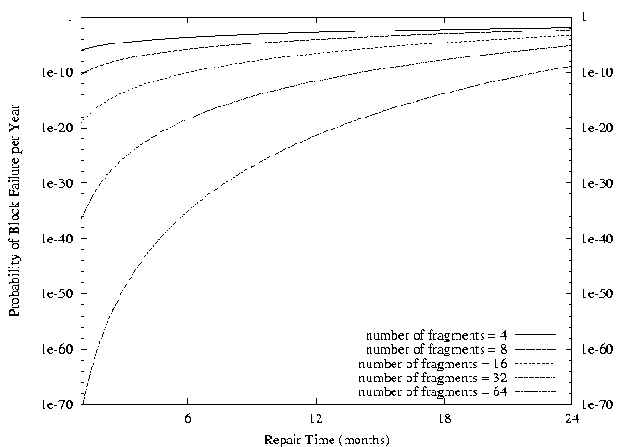
Use of Erasure Coding for High Durability/overhead ratio!
Fraction Blocks Lost
Per Year (FBLPY)
Exploit law of large numbers for durability!
6 month repair, FBLPY with 4x increase in total size of data:
Replication (4 copies): 0.03
Fragmentation (16 of 64 fragments needed): 10⁻³⁵

Slide 27
Higher Durability through Geographic Replication
Highly durable – hard to destroy all copies
Highly available for reads
Simple replication: read any copy
Erasure coded: read m of n
Low availability for writes
Can’t write if any one replica is not up
Or – need relaxed consistency model
Reliability? – availability, security, durability, fault-tolerance
Replica/Frag #1
Replica/Frag #2
Replica/Frag #n

Slide 28
How to make File Systems more Reliable?

Slide 29
File System Reliability: (Difference from Block-level reliability)
What can happen if disk loses power or software crashes?
Some operations in progress may complete
Some operations in progress may be lost
Overwrite of a block may only partially complete
Having RAID doesn’t necessarily protect against all such failures
No protection against writing bad state
What if one disk of RAID group not written?
File system needs durability (as a minimum!)
Data previously stored can be retrieved (maybe after some recovery step), regardless of failure
But durability is not quite enough…!

Slide 30
Storage Reliability Problem
Single logical file operation can involve updates to multiple physical disk blocks
inode, indirect block, data block, bitmap, …
With sector remapping, single update to physical disk block can require multiple (even lower level) updates to sectors
At a physical level, operations complete one at a time
Want concurrent operations for performance
How do we guarantee consistency regardless of when crash occurs?

Slide 31
Threats to Reliability
Interrupted Operation
Crash or power failure in the middle of a series of related updates may leave stored data in an inconsistent state
Example: transfer funds from one bank account to another
What if transfer is interrupted after withdrawal and before deposit?
Loss of stored data
Failure of non-volatile storage media may cause previously stored data to disappear or be corrupted

Slide 32
Two Reliability Approaches
Careful Ordering and Recovery
Versioning and Copy-on-Write
FAT & FFS + (fsck)
Each step builds structure,
Data block ⇐ inode ⇐ free ⇐ directory
Last step links it in to rest of FS
Recover scans structure looking for incomplete actions
ZFS, …
Version files at some granularity
Create new structure linking back to unchanged parts of old
Last step is to declare that the new version is ready

Slide 33
Reliability Approach #1: Careful Ordering
Sequence operations in a specific order
Careful design to allow sequence to be interrupted safely
Post-crash recovery
Read data structures to see if there were any operations in progress
Clean up/finish as needed
Approach taken by
FAT and FFS (fsck) to protect filesystem structure/metadata
Many app-level recovery schemes (e.g., Word, emacs autosaves)

Slide 34
Berkeley FFS: Create a File
Normal operation:
Allocate data block
Write data block
Allocate inode
Write inode block
Update bitmap of free blocks and inodes
Update directory with file name → inode number
Update modify time for directory
Recovery:
Scan inode table
If any unlinked files (not in any directory), delete or put in lost & found dir
Compare free block bitmap against inode trees
Scan directories for missing update/access times
Time proportional to disk size

Slide 35
Reliability Approach #2: Copy on Write File Layout
Recall: multi-level index structure lets us find the data blocks of a file
Instead of over-writing existing data blocks and updating the index structure:
Create a new version of the file with the updated data
Reuse blocks that don’t change much of what is already in place
This is called: Copy On Write (COW)
Seems expensive! But
Updates can be batched
Almost all disk writes can occur in parallel
Approach taken in network file server appliances
NetApp’s Write Anywhere File Layout (WAFL)
ZFS (Sun/Oracle) and OpenZFS

Slide 36
COW with Smaller-Radix Blocks
old version
new version
Write
If file represented as a tree of blocks, just need to update the leading fringe

Slide 37
Example: ZFS and OpenZFS
Variable sized blocks: 512 B – 128 KB
Symmetric tree
Know if it is large or small when we make the copy
Store version number with pointers
Can create new version by adding blocks and new pointers
Buffers a collection of writes before creating a new version with them
Free space represented as tree of extents in each block group
Delay updates to freespace (in log) and do them all when block group is activated

Slide 38
More General Reliability Solutions
Use Transactions for atomic updates
Ensure that multiple related updates are performed atomically
i.e., if a crash occurs in the middle, the state of the systems reflects either all or none of the updates
Most modern file systems use transactions internally to update filesystem structures and metadata
Many applications implement their own transactions
Provide Redundancy for media failures
Redundant representation on media (Error Correcting Codes)
Replication across media (e.g., RAID disk array)

Slide 39
Transactions
Closely related to critical sections for manipulating shared data structures
They extend concept of atomic update from memory to stable storage
Atomically update multiple persistent data structures
Many ad-hoc approaches
FFS carefully ordered the sequence of updates so that if a crash occurred while manipulating directory or inodes the disk scan on reboot would detect and recover the error (fsck)
Applications use temporary files and rename

Slide 40
Key Concept: Transaction
A transaction is an atomic sequence of reads and writes that takes the system from consistent state to another.
Recall: Code in a critical section appears atomic to other threads
Transactions extend the concept of atomic updates from memory to persistent storage
transaction
consistent state 1
consistent state 2

Slide 41
Typical Structure
Begin a transaction – get transaction id
Do a bunch of updates
If any fail along the way, roll-back
Or, if any conflicts with other transactions, roll-back
Commit the transaction

Slide 42
“Classic” Example: Transaction
BEGIN; --BEGIN TRANSACTION
UPDATE accounts SET balance = balance - 100.00 WHERE name = 'Alice';
UPDATE branches SET balance = balance - 100.00 WHERE name = (SELECT branch_name FROM accounts WHERE name = 'Alice');
UPDATE accounts SET balance = balance + 100.00 WHERE name = 'Bob';
UPDATE branches SET balance = balance + 100.00 WHERE name = (SELECT branch_name FROM accounts WHERE name = 'Bob');
COMMIT; --COMMIT WORK
Transfer $100 from Alice’s account to Bob’s account

Slide 43
Concept of a log
One simple action is atomic – write/append a basic item
Use that to seal the commitment to a whole series of actions
Commit Tran N
Start Tran N
Get 10$ from account A
Get 7$ from account B
Get 13$ from account C
Put 15$ into account X
Put 15$ into account Y

Slide 44
Transactional File Systems
Better reliability through use of log
Changes are treated as transactions
A transaction is committed once it is written to the log
Data forced to disk for reliability
Process can be accelerated with NVRAM
Although File system may not be updated immediately, data preserved in the log
Difference between “Log Structured” and “Journaled”
In a Log Structured filesystem, data stays in log form
In a Journaled filesystem, Log used for recovery

Slide 45
Journaling File Systems
Don’t modify data structures on disk directly
Write each update as transaction recorded in a log
Commonly called a journal or intention list
Also maintained on disk (allocate blocks for it when formatting)
Once changes are in the log, they can be safely applied to file system
e.g. modify inode pointers and directory mapping
Garbage collection: once a change is applied, remove its entry from the log
Linux took original FFS-like file system (ext2) and added a journal to get ext3!
Some options: whether or not to write all data to journal or just metadata
Other examples: NTFS, Apple HFS+/apfs, Linux XFS, JFS, ext4

Slide 46
Creating a File (No Journaling Yet)
Find free data block(s)
Find free inode entry
Find dirent insertion point
-----------------------------------------
Write map (i.e., mark used)
Write inode entry to point to block(s)
Write dirent to point to inode
Free space map
Data blocks
…
Inode table
Directory
entries

Slide 47
Creating a File (With Journaling)
Find free data block(s)
Find free inode entry
Find dirent insertion point
-----------------------------------------
[log] Write map (i.e., mark used)
[log] Write inode entry to point to block(s)
[log] Write dirent to point to inode
Free space map
Data blocks
…
Inode table
Directory
entries
tail
head
done
pending
start
commit
Log: in non-volatile storage (Flash or on Disk)

Slide 48
After Commit, Eventually Replay Transaction
All accesses to the file system first looks in the log
Actual on-disk data structure might be stale
Eventually, copy changes to disk and discard transaction from the log
Free space map
Data blocks
…
Inode table
Directory
entries
tail
tail
tail
tail
tail
head
done
pending
start
commit
Log: in non-volatile storage (Flash or on Disk)

Slide 49
Crash Recovery: Discard Partial Transactions
Upon recovery, scan the log
Detect transaction start with no commit
Discard log entries
Disk remains unchanged
Free space map
Data blocks
…
Inode table
Directory
entries
tail
head
done
pending
start
Log: in non-volatile storage (Flash or on Disk)

Slide 50
Crash Recovery: Keep Complete Transactions
Scan log, find start
Find matching commit
Redo it as usual
Or just let it happen later
Free space map
Data blocks
…
Inode table
Directory
entries
tail
head
done
pending
start
commit
Log: in non-volatile storage (Flash or on Disk)

Slide 51
Journaling Summary
Why go through all this trouble?
Updates atomic, even if we crash:
Update either gets fully applied or discarded
All physical operations treated as a logical unit
Isn’t this expensive?
Yes! We're now writing all data twice (once to log, once to actual data blocks in target file)
Modern filesystems journal metadata updates only
Record modifications to file system data structures
But apply updates to a file’s contents directly

Slide 52
Summary
Buffer Cache: Memory used to cache kernel resources, including disk blocks and name translations
Can contain “dirty” blocks (blocks yet on disk)
Important system properties
Availability: how often is the resource available?
Durability: how well is data preserved against faults?
Reliability: how often is resource performing correctly?
RAID: Redundant Arrays of Inexpensive Disks
RAID1: mirroring, RAID5: Parity block
Copy-on-write provides richer function (versions) with much simpler recovery
Little performance impact since sequential write to storage device is nearly free
Use of Log to improve Reliability
Journaled file systems such as ext3, NTFS
Transactions over a log provide a general solution
Commit sequence to durable log, then update the disk
Log takes precedence over disk
Replay committed transactions, discard partials

